Slide 1

|
Digital Banking
Dec 2019
Clustering Base on Transaction Types
Data Science Team
<number>

Slide 2
App Downloads till 23rd June
Find Best Clusters with Machine Learning Technics
Project Introduction
Source Data
Digital App YTD Transactions 2019
Using Machine Learning Algorithm
Kmode Clustering
Hamming Distance
We got Seven Clusters each cluster is performing different types of transaction.
Each Cluster customers performed same types of transaction
Base on similar transactions ML Algorithm assign specific cluster to each customer.
We have to move some cluster customers to another cluster if we have to earn more profit.
We are also using Demo Graphic Customers Details
UBL | where you come first
<number>

Slide 3
App Downloads till 23rd June
Find Best Clusters with Machine Learning Tectonics
Transacting Customers 2019 YTD: 252,117
cluster 0:
10 (Direct Deposit)
cluster 1:
268 (Mobilink - TopUp)
269 (Telenor - TopUp)
cluster 2:
63 (Inter Bank Funds Transfer)
cluster 3:
10(Direct Deposit)
57(Ufone - Prepaid)
63 (Inter Bank Funds Transfer)
176 (Zong - Topup)
cluster 4:
10 (Direct Deposit)
63(Inter Bank Funds Transfer)
cluster 5:
10 (Direct Deposit)
63 (Inter Bank Funds Transfer)
114 (Warid – Prepaid)
268 (Mobilink - TopUp)
cluster 6:
10 (Direct Deposit)
63(Inter Bank Funds Transfer)
147(UBL WIZ RELOAD)
234 (UBL WIZ RELOAD )
UBL | where you come first
<number>

Slide 4
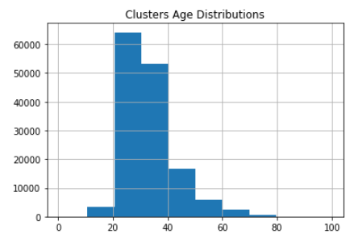
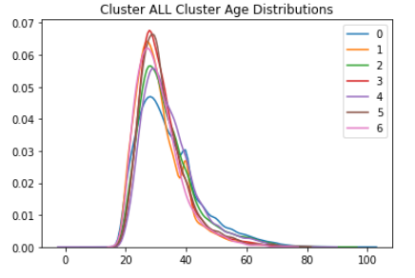
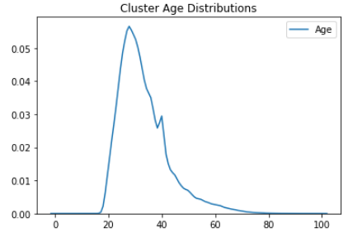
App Downloads till 23rd June
Find Best Clusters with Machine Learning Technics
Transacting Customers YTD: 252,117
Male more than Female in each groups
Mostly Customers are 20 to 40 years olds
UBL | where you come first
<number>

Slide 5
App Downloads till 23rd June
Find Best Clusters with Machine Learning Technics
Transacting Customers YTD: 252,117
UBL | where you come first
<number>

Slide 6
App Downloads till 23rd June
Find Best Clusters with Machine Learning Technics
Transacting Customers YTD: 252,117
UBL | where you come first
<number>

Slide 7
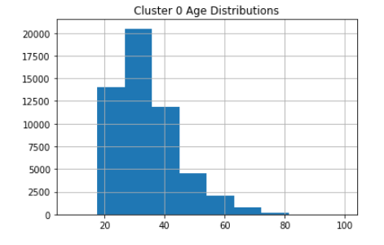
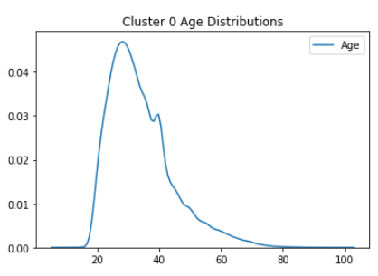
App Downloads till 23rd June
cluster 0: (First begets 1 Cluster)
Total Customers: 85,367
(Direct Deposit)
Cluster 0 Customers Mostly performed just FT they are.
Big Chunk of cluster 0 are 30 to 45 years old.
They Also performed other type of transactions
UBL | where you come first
<number>

Slide 8
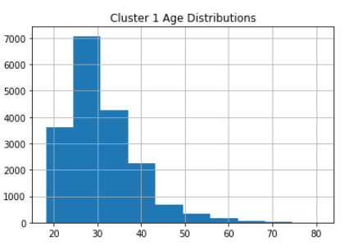
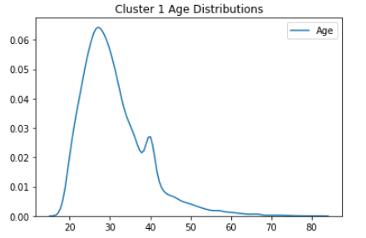
App Downloads till 23rd June
cluster 1: (Fifth begets Cluster)
Total Customers: 31,600
268 (Mobilink - TopUp)
269 (Telenor - TopUp)
Cluster 1 Customers Mostly performed Top-up transactions.
Big Chunk of cluster 0 are 30 to 40 years old.
They Also performed other type of transactions like IBFT
UBL | where you come first
<number>

Slide 9
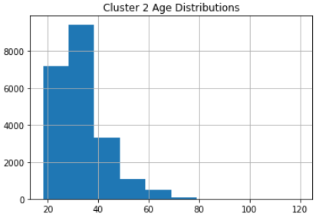
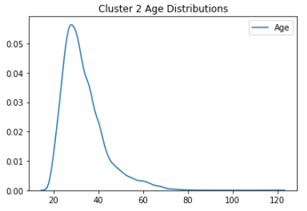
App Downloads till 23rd June
cluster 2: Fourth Biggest Cluster
Total Customers: 39,640
Inter Bank Funds Transfer
Cluster 2 Customers Mostly performed just IBFT they are value able customers
Big Chunk of cluster 2 are 30 to 40 years old.
UBL | where you come first
<number>

Slide 10
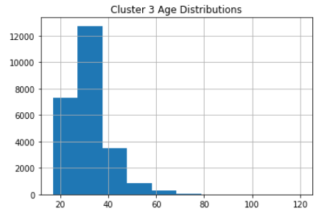
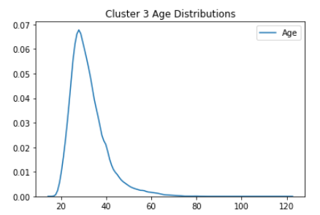
App Downloads till 23rd June
cluster 3: Third Largest Cluster
42,233
Direct Deposit
Ufone - Prepaid
Inter Bank Funds Transfer
Zong – Topup
Here 3 top city is GJR City
UBL | where you come first
<number>

Slide 11
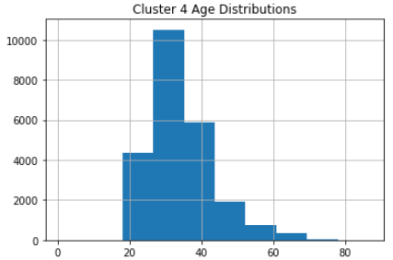
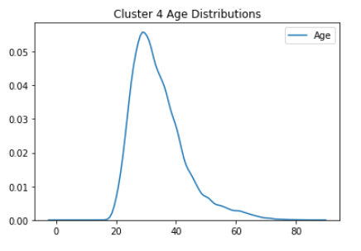
App Downloads till 23rd June
cluster 4: Second Largest Cluster
Total Customers: 44,918
10 (Direct Deposit)
63(Inter Bank Funds Transfer
UBL | where you come first
<number>

Slide 12
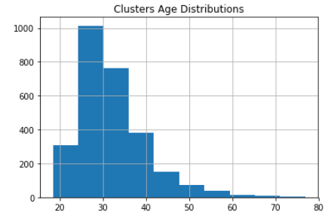
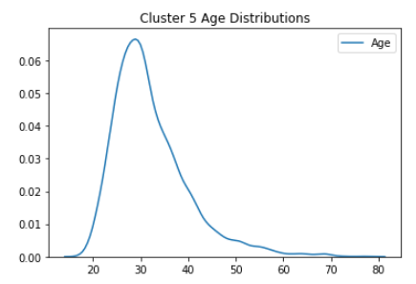
App Downloads till 23rd June
cluster 5:
Total Customers: 6,200
10 (Direct Deposit)
63 (Inter Bank Funds Transfer)
114 (Warid – Prepaid)
268 (Mobilink - TopUp)
UBL | where you come first
<number>

Slide 13
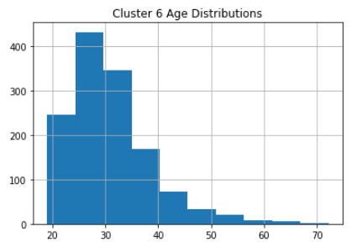
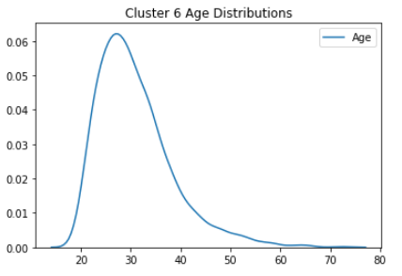
App Downloads till 23rd June
cluster 6:
Total Customers: 2, 159
10 (Direct Deposit)
63(Inter Bank Funds Transfer)
147(UBL WIZ RELOAD)
234 (UBL WIZ RELOAD )
UBL | where you come first
<number>

